Slide 1
HOG based recognition implementation plan (to FPGA)

Slide 2
Object detection using HOG
8pix
8pix
0. Cell is 8x8 pixels, Block is 2x2 Cells, ROI(Image) is 64x128pixels
(Blocks overlap by cell = a cell belongs to 4 blocks)
1. For each pixel, calculate gradation “Orientation” and “Magnitude”
2. For each cell, generate orientation histogram
3. For each cell, generate normalized histogram
3.1. Calculate Σ(Vk² + c): total sum of histogram vote within a block
3.2. for each bin, calculate V’i = Vi / SQRT(Σ (vk² + c))
( a cell belongs to 4 blocks. 4 normalized histograms will be generated for each cell)
4. Calculate Likelihood: dot product with SVM
14bits
v0
v1
v2
v3
v4
v5
v6
v7
v8
14bits
14bits
14bits
14bits
v0
v1
v2
v3
v4
v5
v6
v7
v8
v8
v0
v1
v2
v3
v4
v5
v6
v7
v7
v8
v0
v1
v2
v3
v4
v5
v6
v7
v8
v0
v1
v2
v3
v4
v5
v6
L=
X
+
X
+
X
+
X
+
X
+
X
+
X
+

Slide 3
09/17/2014

Slide 4
Requirements
Input
  FullHD(1920x1080) 30fps
  HD(1280x720) 60fps
WindowSize(64x128pix)
Cell(8x8pix)
Sliding 8pix(vert,hori)
100MHz(FPGA)
9Bins/cell

Slide 5
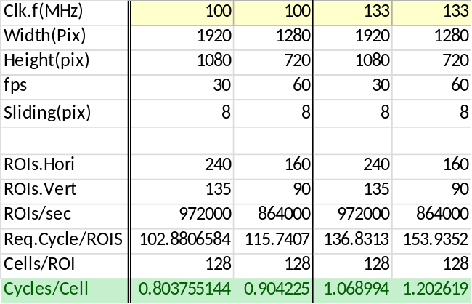
Required performance breakdown
100MHz: Need to complete 2cells / cycle
2 block normalization scale calculation (2sqrt, 2invert)/cycle
9bin normalize with 4 scale x 2cells/cycle = 72 mults
72 dot product calculation/cycle = 72 mults
71 add(36+18+9+4+2+1+1)/cycle
133MHz: 1cells/cycle
1 block normalization scale calculation (1sqrt, 1invert)/cycle
9bin normalize with 4 scale x 1cells/cycle = 36mults
36 dot product calculation/cycle = 36 mults
35 add(18+9+4+2+1+1)/cycle
Pipelined {sqrt, invert} calculation module will be required.
Estimate total 43KB RAM(16KB for I.Buffer, 2.6KB for Scale Buf, 16KB for dot.PsumBuf, 8KB for SVM)

Slide 6
MainMem
Parameter
Block Level
4KB/transaction?
MemReadI/F
BlkController
Ld. 6 Sq.Sum
Hist/SumSq Buf
6 Sq.Sum
4 Sq.Sum
4 Sq.Sum
Pipelined calc. required
1920/8 * 9bin *14bit * 2lines
110KBit=13KByte
1920/8 * 28bit * 2lines=3KByte
Sqrt(S.Sum+C)
Sqrt(S.Sum+C)
Ld. 9x2bins
(2cells)
16b/cycle
16b/cycle
Inv(Sqrt(S.Sum+C))
Inv(Sqrt(S.Sum+C))
16b/cycle
1920/8 * 16bit * 3 lines = 2.6KByte
16b/cycle
Cell
Controller
ScalesBuf
scale0
scale1
scale2
scale0
scale1
scale2
scale3
9BINData/cycle
9BINData/cycle
scale3
Normalize.Histg
Normalize.Histg
Normalize
Normalize
Normalize
Normalize
Normalize
Normalize
Normalize
Normalize
x
x
x
x
x
x
x
x
x
x
x
x
x
x
x
x
x
x
x
x
x
x
x
x
x
x
x
x
x
x
x
x
x
x
x
x
x
x
x
x
x
x
x
x
x
x
x
x
x
x
x
x
x
x
x
x
x
x
x
x
x
x
x
x
x
x
x
x
x
x
x
x
14bit*9bin*4/cycle
14bit*9bin*4/cycle
Classification.for a cell
Classification.for a cell
SVM.Mem
SVM.Mem
SVM.Mem
SVM.Mem
SVM.Mem
SVM.Mem
SVM.Mem
SVM.Mem
dotP
dotP
dotP
dotP
dotP
dotP
dotP
dotP
x
x
x
x
x
x
x
x
x
x
x
x
x
x
x
x
x
x
x
x
x
x
x
x
x
x
x
x
x
x
x
x
x
x
x
x
x
x
x
x
x
x
x
x
x
x
x
x
x
x
x
x
x
x
x
x
x
x
x
x
x
x
x
x
x
x
x
x
x
x
x
x
N.Hist Output Buf
Adder.tree
Adder.tree
Adder.tree
Adder.tree
Adder.tree
Adder.tree
Adder.tree
Adder.tree
+
+
+
+
+
+
+
+
+
+
+
+
+
+
+
+
+
+
+
+
+
+
+
+
+
+
+
+
+
+
+
+
+
+
+
+
+
+
+
+
+
+
+
+
+
+
+
+
+
+
+
+
+
+
+
+
+
+
+
+
+
+
+
+
+
+
+
+
+
+
+
+
+
+
+
+
+
+
+
+
+
+
+
+
+
+
+
+
+
+
+
+
+
+
+
+
MemWriteI/F
(N+2) bits for each 4cycle
Horz.Acc+= CellA.dot + CellB.Dot
Nbit*240ROIs * 16Lines
= 3,840 * N = 16KByte?
N.Hist Total: 14bit * 9 * 240 * 135 * 4 = 2MByte /Frame
Sum.dotP Buf
Sum.Dot: Mbit * 240 * 135 = 129KByte/Frame
Ld. 4xHoriz.AccResult
(4cycle to get a ROI’s sum of dot products)
Vert.Acc+= Horz(x).Acc

Slide 7
Mode1:Block(=2x2cell) normalized cell histograms output

Slide 8
Mode2: Classification(Sum of dot products (16x8cellsx4histx9bin and SVM)) output
Mode2: Classification(Sum of dot products (16x8cellsx4histx9bin and SVM)) output
  Input cell histograms within a frame
    (9bin hist &Sum.Sq /cell) * (FrameSize/CellSize)
  Output sum of dot products for each ROI
Σ dot
Σ dot
Σ dot
Σ dot
Σ dot
Σ dot
Σ dot
Σ dot
Σ dot
Σ dot
Σ dot
Σ dot
Σ dot
Σ dot
Σ dot
Σ dot
Σ dot
Σ dot
Σ dot
Σ dot
Σ dot
Σ dot
Σ dot
Σ dot
Σ dot

Slide 9
Issues
WindowSize(64x128pix)(or number of cells in a windows) need to be configurable?
Cell size(8x8pix) need to be configurable?
  If number of cells in a windows was configurable, classification part (reference to SVM memory) must be flexible
  Required size for input buffer and scales buffer is detemined by number of horizontal cells in a frame(i.e. 1920/8pix)
9Bins/cell or 16bins/cell??
  If we support 16bins/cell, normalization part and classification part will be big

Slide 10
Impl.Memo: Target cell or block position relationship between each submodules
sqrt
Normalization
cell
0
0
1
1
2
2
3
3
2
2
3
3
4
4
5
5
6
Clk cycle
4
4
5
5
6
7
7
6
6
7
7
8
8
9
9
8
8
9
9
10
10
11
11
10
10
11
11
12
12
13
13
12
12
13
13
14
14
15
15
14
14
15
15
block
inv
dotProduct
1
1
2
2
3
3
4
4
3
3
4
4
5
5
6
6
5
5
6
6
7
7
8
8
7
7
8
8
9
9
10
10
9
9
10
10
11
11
12
12
11
11
12
12
13
13
14
14
13
13
14
14
15
15
15
15

Slide 11
Impl.Memo: Dot product (vertical) acc.
1
1
2
2
3
3
4
4
Sum.dotP Buf
5
5
6
6
7
7
8
8
ROI
1
1
2
2
3
9
9
10
10
11
11
12
12
13
13
14
14
15
15
32b
32b
Vert.Acc+= Horz(x).Acc
32b
Horizontal Sum of dot products
32b

Slide 12
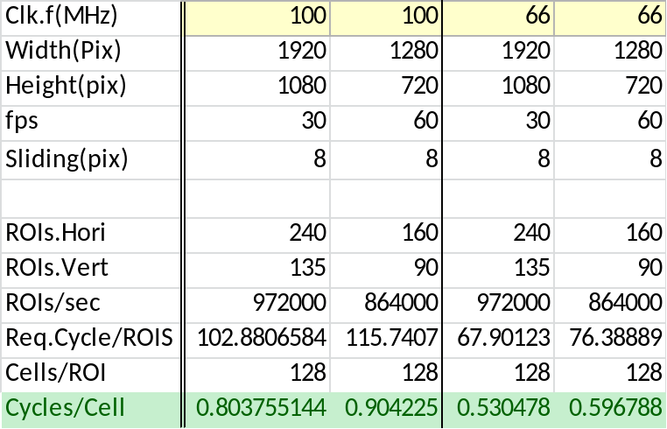
Perf.Memo
With 2 parallel structure,
we can meet perf. Requirement
with 66 MHz

Slide 13
09/16/2014

Slide 14
Outline of the accelerator
Load HOG generated by Histogram acc. from main memory
Execute:
Output normalized histograms or dot product result with SVM (or both of that)
Performance: 8,192cycle/ROI(ROI=64x128pixels)
    (8x16)cells x 4 Block x 16cycles/{1cell,1block}
    Input/Output data bandwidth is not considered.
3. For each cell, generate normalized histogram
3.1. Calculate Σ(Vk² + c): total sum of histogram vote within a block
3.2. for each bin, calculate V’i = Vi / SQRT(Σ (vk² + c))
( a cell belongs to 4 blocks. 4 normalized histograms will be generated for each cell)
4. Calculate Likelihood: dot product with SVM

Slide 15
Resources estimation
Memory ( for 64x128pixel/ROI configuration)
  0.5KByte for input buffer(or 1KB w/easy impl.)
  8KByte for SVM memory
  Memory for output buffer is not estimated
Logic
  Major functional units are
    Sqrt(use 16 cycles to generate one 16bit output) x 1
    Invert calculation(use 16 cycles to generate one 16bit output) x1
    14b*14b mult x 5, 14b*16b mult x 1
    More than 32 bit adder x 1(for dot product result accumlation)

Slide 16
Abstract image of the accelerator
(in N.Hist output mode)
64pix(8cells)
14bits
ROI(Image)
14bits
14bits
14bits
9bins
9bins
9bins
14bits
9bins
128pix(16cells)
9bins
14bits x 9bins x (8x16) cells
=2.4KByte
HOG
MainMemory
2.4KByte/11,264cycle
InputBuffer
(1.2KByte)
accelerator
14bits
Calc.NormScale
1/Sqrt(ΣVk+C)
14bits
14bits
14bits
9bins
9bins
14bits
9bins
9.6KByte
14bits
9bins
14bits
14bits
9bins
9bins
Normalization
9bins
9bins
9.6KByte/11,264cycle
14bits
14bits
14bits
14bits
9bins
9bins
9bins
9bins

Slide 17
Abstract image of the accelerator
(in Likelihood output mode)
64pix(8cells)
ROI(Image)
14bits
14bits
14bits
14bits
9bins
9bins
9bins
14bits
9bins
128pix(16cells)
9bins
14bits x 9bins x (8x16) cells
=2.4KByte
HOG
MainMemory
2.4KByte/11,264cycle
InputBuffer
(1.2KByte)
accelerator
Calc.NormScale
1/Sqrt(ΣVk+C)
Normalization
x SVM
SVM Mem
8KByte
Less than 64bits/11,264cycle

Slide 18
Block Level
n
A
B
n
0 1 2 … k
MainMem
ROI queue??
Hist BufSize
C
D
Fetch Target
4KB/transaction?
MemReadI/F
BlkController
clkX+00: A{0,1,2,3}.bin[0],A1.bin[0],A2.bin[0],A3.bin[0]
clkX+01: A{0,1,2,3}.bin[1],A1.bin[1],A2.bin[1],A3.bin[1]
…
clkX+ k: A{0,1,2,3}.bin[k],A1.bin[k],A2.bin[k],A3.bin[k]
clkX+k+1: A{0,1,2,3}.bin[0],B1.bin[0],C2.bin[0],D3.bin[0]
…
HistBuf
Ld.4BIN
{[A-D],[0-k]}/clk
S: required cycle to get a Sqrt. (S≒SqrtBits)
This will be a bottleneck (if S < (K+1))
4BINData
[A-D]{0,1,2,3}.bin[0-k]/clk
14bits per bins
* 9bins
* 4verticalCells
* H horizontal Cells
14 * 9 * 4 * 8
= 4Kbits
<powSum>
x+=(h₀^2+h₁^2+h₂^2+h₃^2)+CONST
a “Σ (h_{i}^2 +c)” for each 16 cycle step
Sqrt(x)
a “Sqrt(Σ (h_{i}^2 +c))” for each 16 cycles
Calc:Sqrt(x)⁻¹
a “1/(Sqrt(Σ (h_{i}^2 +c) ) )” for each 16 cycle step
Ld.1BIN / clk
CellController
Ld.1SVMData / clk
1BINData/cycle
h_{i}*Sqrt(x)⁻¹*SVMData
SVM
1Nomalized BIN/cycle
N.HistBuf
+=
9*4*(8*16) deimensions/8,192cycle
1 likelihood/8,192cycle
MemWriteI/F
Mem??

Slide 19
BlkController
Input
  Loaded Bins[BlkSize]
Output
  RegionEnd_flag
  BlkEnd_flag
  [A-D]flags (center cell position in block)

Slide 20
HistBuf
Bank structue
1Write(to a bank)
4Read(from 4 banks)
Simultaneous Read and Write access to a bank is note required
0
4
8
12
0
4
8
12
1
5
9
13
1
5
9
13
2
6
10
14
2
6
10
14
3
7
11
15
3
7
11
15

Slide 21
powSum
Configuration
  Constant[15:0]
FFs:
  rAcc[31:0]
  rMulResult[27:0]
Operation: “Σ(Vk^2 + CONST)”
Input
  4bin data(14bit?)
  BlkEndFlag
  [A-D]flags
Output (1output per S clks)
  Σ(h^2 + const)
  BlkEndFlag
  [A-D]flags
8bit/pix
MaxHistVote=8bitx8x8votes => 14bits = max16383
Mul.ResultMax = 28bit=max268,402,689
Sum of MulResult in a hist => only 28bit
4 cells in a block=>28bit x 4 = 30 bit
2^30 – 1 - (4 cell add result max1,073,610,756) = 131067
After add const, fit 30 bits
acc = ConstantParam.
for(cells in a block){
for(bins in a histogram) {
acc += bin[i] * bin[i]; // mul.result = 28bit
}
}

Slide 22
Sqrt
F/Fs
  rResult[15:0]; // fixed point value (unsigned 15.1)
Operation: “Sqrt(Σ(Vk^2 + CONST))”
Input
  powSum’s ouptut
  BlkEndFlag
  [A-D]flags
Output
  SqrtResult
  BlkEndFlag
  [A-D]flags
  rResult = 0;
  for(i=15; i >= 0; i--){
  tmp = (rResult | (1<<i);
  if(tmp*tmp < (in<<2)){
  rResult = tmp;
  }
  }

Slide 23
InvSqrt
FFs
  rResult[15:0]: fixed point(2.14)
Operation: “1/Sqrt(Σ(Vk^2 + CONST))”
Input
  SqrtResult
  BlkEndFlag
  [A-D]flags
Output
  NormalizationScale
  BlkEndFlag
  [A-D]flags
  rResult = 0;
  for(i=15; i >= 0; i--){
  tmp = (rResult | (1<<i);
  if(tmp*in < (1<<(14+1)){
  rResult = tmp;
  }
  }

Slide 24
CellController
Input
  NormalizationScale
  BlkEndFlag
  [A-D]flags
Output
  Load2HistBuf
  Load2SVMMem
  BlkEndFlag
  [A-D]flags

Slide 25
mulSvm
Operation
  h_{i}* (1/Sqrt(Σ(Vk^2 + CONST)) *SVMData_{i}
  TBD: mults accuracy
Input
  binData
  A SVM data
Output
  A mult result

Slide 26
acc
Input
  BlkEndFlag
  A mult result
Output
  Result [TBD bit accuracy]

Slide 27
TBD
How to set SVM data
Read/Write Mem.I/F implementation

Slide 28
TBD: Flexibility to *
Don’t care cell size in pixel
  Load histogram(for each cell) only
  Sum of magnitudes in a cell should be less than 2^14
Block Size must be 2x2cells
  Not difficult to support 1x1.(but not planning to support.)
  Difficult(but not impossible) to support 4x4, 2x4, 4x2
Not difficult to ROI sizes
  {32,64,128,256,…} x {32,64,128,256,…}
  Need to expand buffer size to support ROI width larger than 128.
Num. of bin in a histogram should be less than cycles that sqrt use.(16?)

Slide 29
Memo
4 times faster implementation:
  This implementation execute only 1block at a certain period. Parallelization to execute 4 blocks will be possible
  (or just use 4 modules in a ASIC)
16times faster imple:
  Parallelize to calculate 4blocks & 4 cells.

